Slide 1
Blockchain Technology Bitcoin and Beyond
Deepak Jagyasi

Slide 2
Agenda
What is a Blockchain
How does a Blockchain get built
Weaknesses of Blockchain technology
Current applications of Blockchain technology
Future applications of Blockchain technology
What is a cryptocurrency – Bitcoin, Ether
Solidity Coding for Ethereum platform
Demo of Solidity DApp
Q & A

Slide 3
Blockchain Defined
Simply defined a Blockchain is little more than a:
Open
Distributed / P2P Network
Ledger
Secure
Immutable / Permanent
- Blockchain in not as much a Technology as it is a Philosophy
- A digital currency was in a lot of ways the first demonstrable use of Blockchain

Slide 4
Benefits of Blockchain
Faster settlement
Decentralized
Immutable
Secured / Trustable
Disruption of internet caused
- Information
- Distribution
- Communication
- Trust
- Disintermediation

Slide 5
Some Prerequisites
Distributed computing
Cryptography
Confidentiality – Public key cryptography
Authentication – Digital Signature
Integrity
Non Repudiation

Slide 6
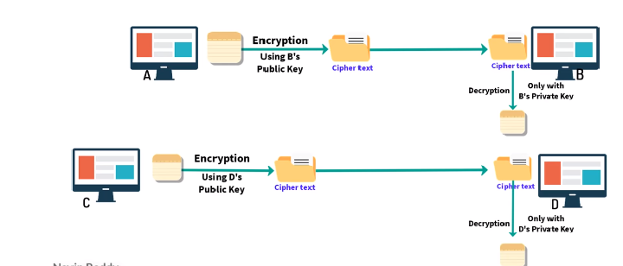
Types of Cryptography
Symmetric Key cryptography
Asymmetric Key cryptography

Slide 7
Abbreviations
Node –
Full Node – Current size 188 GB
Can Verify and Store the complete blockchain
Partial Node / Lite node -
Miners
Hashing – MD5 (message digest), SHA256 (Secure Hash Algo)
Converts the input to hash keys

Slide 8
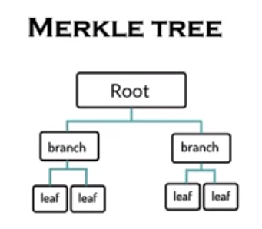
Abbreviations
Hashing vs Encryption:
In Hashing you cannot get the data back
In Encryption data can be decrypted using the keys
Merkle Tree –

Slide 9
One Common Thing
Banks
Uber
OYO
Airbnb
Google
Facebook
Amazon
Microsoft
Britannica
Election Commission
Government

Slide 10
Block Architecture in Blockchain
Timestamp
Transactions
Version
Merkle Root
Difficulty
Nonce
Previous Hash

Slide 11
Types of Blockchain
Public – Permissionless
(e.g – Bitcoin)
Private – Permissioned
(Restricted for Single company)
Federated Blockchain

Slide 12
Types of Blockchain
Centralized Network
Decentralized Network
Distributed Network

Slide 13
Proof of Work
- Verify all the previous transactions
- Invest Time and computing Power
- To solve mathematical problem
- Wastes lot of energy and does computation which is useless

Slide 14
Ethereum.org
Contracts are the main building blocks of Ethereum.
A contract is a computer program that lives inside the distributed Ethereum network and has its own ether balance, memory and code.
Every time you send a transaction to a contract, it executes its code, which can store data, send transactions and interact with other contracts.
Contracts are maintained by the network, without any central ownership or control.
Contracts are written in languages instantly familiar to any programmer and powered by Ether, Ethereum's cryptofuel.

Slide 15
DApps
Ethereum is open software platform which helps to create Decentralized Applications

Slide 16
Smart contracts
Smart contracts are the codes which perform an activity based on certain event e.g. If… then…
Distributed ledgers enable the coding of simple contracts that will execute when specified conditions are met using Solidity Programming language.
Ethereum is an open source blockchain project that was built specifically to realize this possibility. Still, in its early stages, Ethereum has the potential to leverage the usefulness of blockchains on a truly world-changing scale.

Slide 17
Solidity
Solidity is an object-oriented, high-level language for implementing smart contracts.
Smart contracts are programs which govern the behaviour of accounts within the Ethereum state.
A contract in the sense of Solidity is a collection of code (its functions) and data (its state) that resides at a specific address on the Ethereum blockchain.

Slide 18
Notable Blockchain Dapps/Projects
Storj.io
Follow my vote
Blockverify

Slide 19
Drawbacks of Blockchain (Public Blockchain)
Complex – Algorithms, terminologies, architecture
Slow speed – 1000 txs/sec vs Bitcoin 7- 10 txns/sec
Wastage of resources – PoW consume lots of resources
Security / Privacy –
51 % Attack – Malicious nodes

Slide 20
What is Bitcoin
A protocol that supports a decentralized, pseudo-anonymous, peer-to-peer digital currency*
A publicly disclosed linked ledger of transactions stored in a blockchain
A reward driven system for achieving consensus (mining) based on “Proofs of Work” for helping to secure the network
A “scare token” economy with an eventual cap of about 21M bitcoins

Slide 21
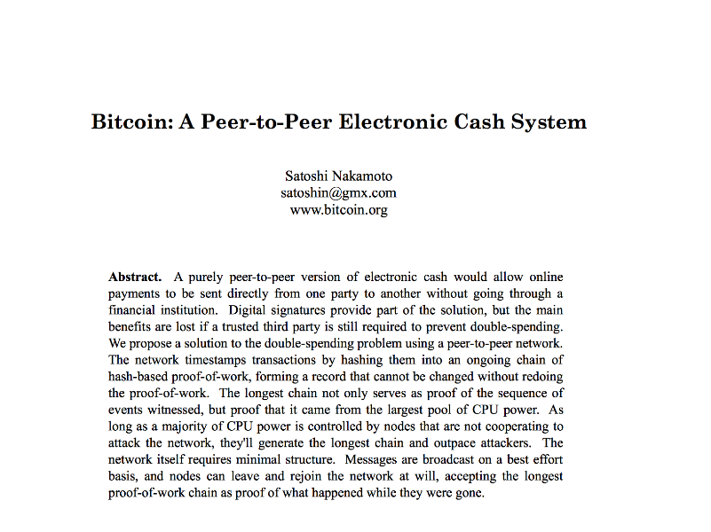
Bitcoin Whitepaper – 2008.10.31*

Slide 22
Features of Bitcoin
Essentially it’s “deflationary” – the reward is cut in half every four years, and tokens can be irrevocably destroyed
Nearly infinitely divisible currency units supporting eight decimal places 0.00000001 (known as a Satoshi or Noncent*)
Nominal transaction fee’s paid to the network
Same cost to send $.01 as $1,000,000
Consensus driven – no central authority
Counterfeit resilient
Cannot add coins arbitrarily
Cannot be double-spent
Non-repudiation– no recourse and no one to appeal to return sent tokens
http://www.urbandictionary.com/define.php?term=Noncents

Slide 23
When did it start?
“Satoshi Nakamoto” created the reference implementation that began with a Genesis Block of 50 coins
2008
August 18 Domain name "bitcoin.org" registered^{[1]}.
October 31 Bitcoin design paper published
November 09 Bitcoin project registered at SourceForge.net
2009
January 3 Genesis block established at 18:15:05 GMT
January 9 Bitcoin v0.1 released and announced on the cryptography mailing list
January 12 First Bitcoin transaction, in block 170 from Satoshi to Hal Finney
https://en.bitcoin.it/wiki/History

Slide 24
Why does it have value?
The worth of a thing
is the price it will bring.

Slide 25
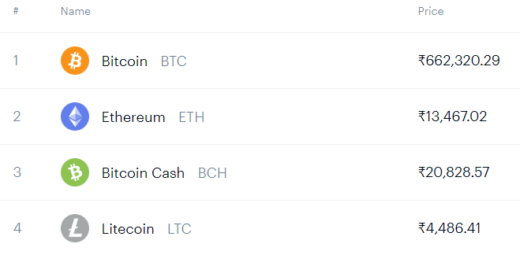
Why does it matter?
3.6 Billion Dollar Market Cap!

Slide 26
Decentralized
The “digital wallet” operates in a peer to peer mode
When it starts it bootstraps to find other wallets
Originally it used the Internet Relay Chat (IRC) network
Now based on DNS and “seed nodes”
The wallet will synchronize with the network by downloading ALL of the transactions starting from the GENESIS block if necessary
602 471 blocks at time of slide prep
Just over 230 GB
Using a “gossip protocol” the wallets share all transaction information with their peers http://en.wikipedia.org/wiki/Gossip_protocol

Slide 27
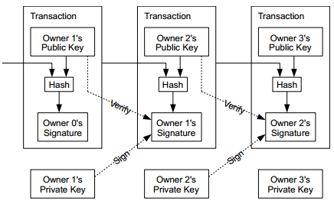
Coins flow from Inputs to Outputs
A coin owner transfers coins by digitally signing (via ECDSA) a hash digest of the previous transaction and the public key of the next owner. This signature is then appended to the end of the coin.

Slide 28
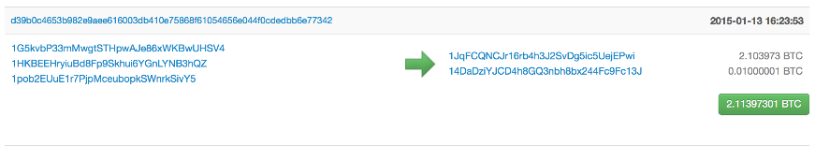
Pseudo Anonymous
Using public key cryptography, specifically Elliptic Curve Cryptography due to its key strength and shorter keys
Transactions are sent to public key “addresses”
1AjYPi8qryPCJu6xgdJuQzVnWFXLmxq9s3
1Give4dbry2pyJihnpqV6Urq2SGEhpz3K

Slide 29
Addresses are like Accounts
The wallet listens for transactions addressed to any of its public keys and in theory is the only node that is able to decrypt and accept the transfer
“Coins” are “sent” by broadcasting the transaction to the network which are verified to be viable and then added to a block
Keys can represent a MULTI-SIG address that requires a N of M private keys in order to decrypt the message

Slide 30
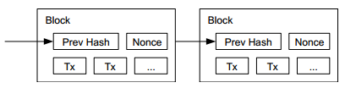
Public Ledger
Every viable transaction is stored in a public ledger
Transactions are placed in blocks, which are linked by SHA256 hashes.
https://blockchain.info

Slide 31
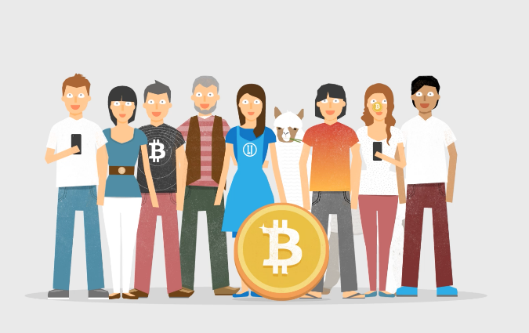
“What is Bitcoin” – Video
http://weusecoins.com

Slide 32
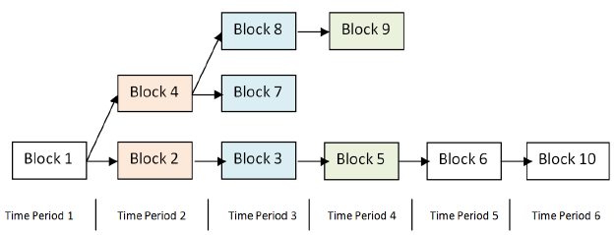
Arriving at Consensus
Although the accepted chain can be considered a list, the block chain is best represented with a tree.
The longest path represents the accepted chain.
A participant choosing to extend an existing path in the block chain indicates a vote towards consensus on that path. The longer the path, the more computation was expended building it.

Slide 33
Consensus Process = Mining
Originally the digital wallet could also participate in the consensus process by attempting to secure the network directly
This process is known as “mining”
Mining involves attempting to find a numerical value, known as a “nonce” that when combined with all open transactions can be “hashed” into a value that satisfies a certain “difficulty”
Custom, purpose built-hardware has long since replaced the function such that its no longer productive for simple CPU based systems to compete in the mining process, and thus it was removed

Slide 34
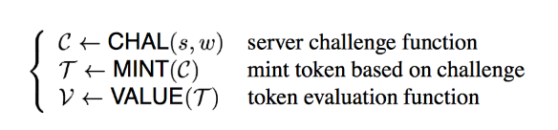
Proof of Work / Hashcash (Or How to Pay a Byzantine Generals Salary)
Like many great ideas to become realized, it takes a confluence of other great ideas
Based on the idea of HashCash, a Proof of Work concept invented by Adam Back in 1997 (http://www.hashcash.org/papers/hashcash.pdf)
Originally proposed as an anti-spam throttling mechanism
The core idea is that before accepting a transaction, the sender must first demonstrate a “cost” via a computationally “hard” problem that can simultaneously be easily verified.
This generally referred to as a “Proof of Work”

Slide 35
Proof of Work
A publicly auditable cost-function can be efficiently verified by any third party without access to any trapdoor or secret information.
A fixed cost cost-function takes a fixed amount of resources to compute. The fastest algorithm to mint a fixed cost token is a deterministic algorithm.
A probabilistic cost cost-function is one where the cost to the client of minting a token has a predictable expected time, but a random actual time as the client can most efficiently compute the cost-function by starting at a random start value. Sometimes the client will get lucky and start close to the solution.

Slide 36
The Role of Hashing
A hash function is any function that can be used to map digital data of arbitrary size to digital data of fixed size, with slight differences in input data producing very big differences in output data.
MD5, SHA1, SHA256
For example, the MD5 hashes of ‘abc’ compared to ‘abC’
abc
0bee89b07a248e27c83fc3d5951213c1
abC
2217c53a2f88ebadd9b3c1a79cde2638
“The Quick Brown Fox Jumped Over the Lazy Dog”
2dfd75162490ed3b4c893141f9ab37cf

Slide 37
The Hash Lottery
Hashing is straightforward, but not challenging
Unless the goal is to say, find me a hash value that satisfies a certain level of “difficulty”
For example, let’s say the challenge is find a hash-value that begins with a number of zeros, for a given input
The Proof of Work comes from finding a number (known as a NONCE) that when added to the input changes the output of the hash value to satisfy the difficulty.
In the Bitcoin world this is what “mining” is and in effect is little more than a lot of hash-power spent on guessing winning lottery numbers that satisfy the difficulty of the problem in order to obtain the reward from the network

Slide 38
The Payout
The node that finds the best solution to the challenge is provisionally granted a reward
Originally in Bitcoin it was 50 new coins
Competing solutions are evaluated based on which node offers the higher number of transactions included in the candidate block as well as the level of over-satisfying the difficulty.
For example, if two nodes offer a solution to the challenge and both have the same number of transactions, the reward will go to the node that found a NONCE that beat the challenge
E.G. Find a hash that begins with 4 zeros
The node that supplies a hash that has 5 zeros beats the node that only finds the minimum

Slide 39
Transaction Confirmation
Having a transaction provisionally accepted into a candidate block signals that the network has verified that the inputs were viable
Every new block accepted into the chain after the transaction was accepted is considered a confirmation
Coins are not considered mature until there have been 6 confirmations (basically an hour assuming a 10 minute block cadence)
New Coins created by the mining process are not valid until about 120 confirmations
This is to assure that a node with more than 51% of the total hash-power does not pull off fraudulent transactions

Slide 40
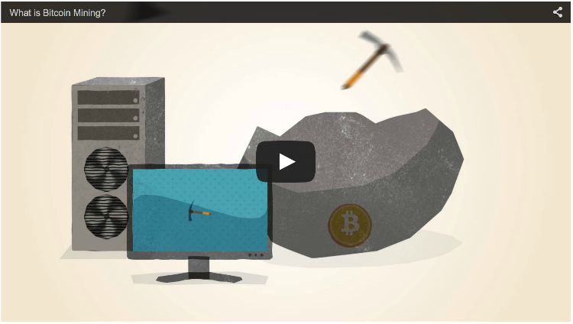
“What is Bitcoin Mining” – Video
http://www.bitcoinmining.com

Slide 41
Why 51% Matters
“When does 1 + 1 = 3 ?” *
In the case of Bitcoin “consensus” goes to the chain with the highest number of blocks
Not just in theory, but in practice several large mining pools have generated six blocks in a row
To date the network has voluntarily shifted its mining power around or faced Distributed Denial of Service attacks
* When everyone says it does!

Slide 42
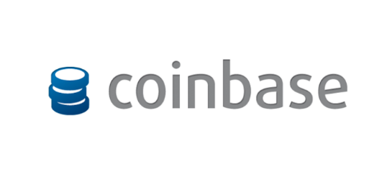
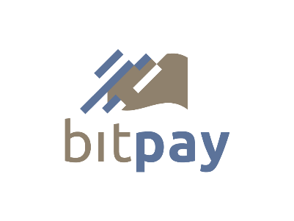


Purchase / Exchange Bitcoins
In addition to mining bitcoins, they can be acquired from an exchange!

Slide 43

Who Accepts Bitcoins?

Slide 44
Other Uses of Blockchain Tek
Registeries
Authoritative Systems of Record
Directory Services
Timestamping Services (“Proof of Existence”)
Counter-party Exchanges

Slide 45
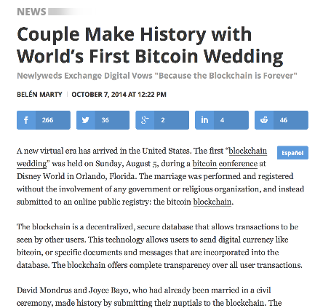
Registries

Slide 46
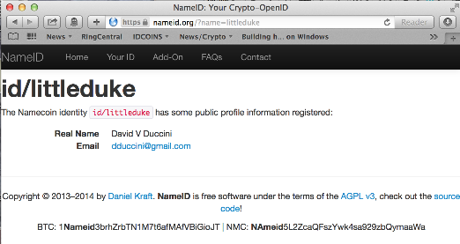
Namecoin
The first fork of Bitcoin with a purpose
Securely record and transfer arbitrary names (keys).
Attach a value (data) to the names
(up to 520 bytes, more in the future).
Transact namecoins, the digital currency (ℕ, NMC).

Slide 47
Namecoin as a fault-tolerant Domain Name System
Can act as a decentralized Domain Name Service that is resilient to censorship
http://bit.namecoin.info

Slide 48
Alternates to Bitcoin aka Altcoins
“Good artists copy. Great artists steal.”
The first alternate blockchain was Namecoin
Early attempts to “re-level the playing field” were made by changing the hashing function from SHA256 to SCRYPT
SCRYPT is a “memory intensive” function that was thought to be resistant to customized hardware (false)
Changes to the block emit time target were also changed from Bitcoins 10 minutes to 2.5 minutes to increase the velocity
Newer ALTS incorporate every escalating hash functions, chained together in novel ways to resist giving purpose built hardware an advantage over CPU based mining

Slide 49
A Babel of Altcoins
Now well over 500 “alternate” coins to Bitcoin
99.999% of them are simply brands / clones
Most tinker with:
the total coin supply
the hashing functions (SHA256, SCRYPT, X11 et al)
block emit time targets
Proof of Something (Proof of Work, Proof of Stake)
Notable Alts: Ripple, Litecoin, Dogecoin
Total Market Cap: $ 4,540,315,390 (Bitcoin is 3.6B of that)
http://coinmarketcap.com

Slide 50
Bitcoin 1.5
COUNTERPARTY.ORG
Counterparty works by storing extra data in regular Bitcoin transactions, which makes every Counterparty transaction a Bitcoin transaction, albeit a very small one.
MASTERCOIN.ORG
The Master Protocol facilitates the creation and trading of smart properties and user currencies as well as other types of smart contracts.
Mastercoins serve as the binding between bitcoins (BTC), smart properties and smart contracts created on top of the Mastercoin Protocol.
NXT.ORG
Asset creation and exchange on its own blockchain

Slide 51
Bitcoin 2.0
Smart Contracts
Escrow-free exchange
Insurance
Voting
Distributed Autonomous Organizations
Identity & Reputation Systems
http://bit.ly/idcoins
Notable Implementations

Slide 52
Bad Uses for Good Technology “Guns Don’t Kill People. People Kill People”
Bitcoin has had its fair share of “bad press”
Silk Road
An online anonymous marketplace for “censorship-free” commerce
Ross Ulbricht’s trial starts this week
Bitinstant
Charlie Shrem plead guilty to aiding money laundering
MT-GOX
aka “Magic The Gathering Online eXchange”
700,000 coins “missing”
Ransomware
Bitstamp

Slide 53
Resources
Bitcoin: A Peer-to-Peer Electronic Cash System https://bitcoin.org/bitcoin.pdf
http://coinmarketcap.com
Hashcash.org
IDCoins: A Web of Trust Blockchain for Identity and Reputation, David V Duccini, http://bit.ly/idcoins
“Mastering Bitcoin”, Andreas M.Antonopoulos , O’Reilly Media
http://www.bitcoinsecurity.org/2012/07/22/what-is-bitcoin/
https://www.weusecoins.com

Slide 54
Q&A
?

